Slide 1

Helping Individuals
&
Families Navigate
Transitions
In Care
Rev. Karen Fox, BBS, BRE, MDiv
CSCP (CASC), RP(CRPO)
Chaplain, Spiritual Care, Baycrest
Clinical Supervisor-Educator, Clinical Pastoral Education

Slide 2
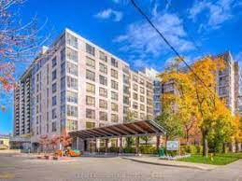

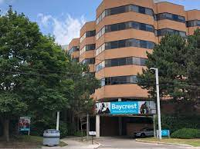
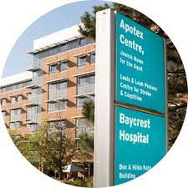
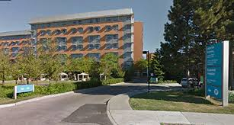
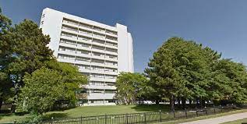

Slide 3

Statistics on Aging

Slide 4
Statistics Canada
Over 861,000 people aged 85 and older were counted in the 2021 Census, more than twice the number observed in the 2001 Census.^{Note1}
The population aged 85 and older is one of the fastest-growing age groups, with a 12% increase from 2016. Currently, 2.3% of the population is aged 85 and older.
Notes:
April 27/2022

Slide 5
Statistics Canada
Over the next 25 years (by 2046), the population aged 85 and older could triple to almost 2.5 million people.
Over 9,500 centenarians are now living in Canada —
  a 16% increase from 2016.
  Centenarians represent 0.03% of the Canadian population.

Slide 6
Statistics Canada
As a significant proportion of people aged 85 and older have activity limitations or health-related issues
more than one-quarter live in a collective dwelling:
  such as a nursing care facility,
  long-term care facility or
  seniors’ residence.
This proportion increases with age.

Slide 7
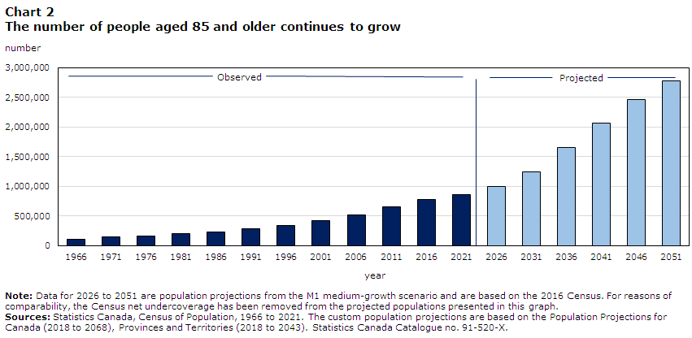
Projected # of People 85+

Slide 8
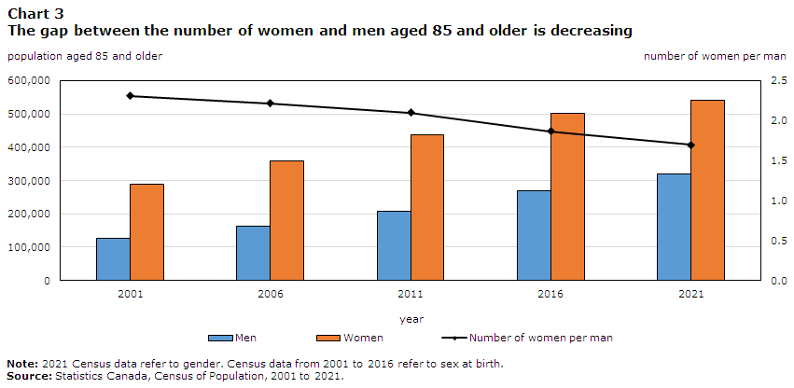
Gap Between Men & Women 85+

Slide 9
Personal Reflections Aging
Notes:
Break Out: What are some of your ideas and thoughts about aging?

Slide 10
Changes in Body Systems
Vision
Auditory
Skin, elasticity, thinning, decreased blood flow
Musculoskeletal
Cardiovascular
Renal & Bladder
Gastrointestinal changes
Neurological
Pulmonary

Slide 11
Common Conditions Seen in Older Adults
Pre-Pandemic
Diabetes mellitus (29.6%)
Anxiety disorders (27.7%)
Chronic obstructive lung disease (19.7%)
Stroke (18.9%)
Cancer (17.1%)
Cardiac Arrythmia (15.3%)
Congestive heart failure (9.1%)
Mood Disorders (7.7%)
Dementia (7.6%)
Ischemic heart disease (5.0%)
Substance related disorders (4.0%)
Falls (3.6%)
Parkinson’s Disease (0.9%)
Schizophrenia/Psychotic disorders (0.9%)
Approximately 3% living in Long Term Care
Prevelance of Conditions Seen in Older Adults (2019)
Notes:
Many older adults live with good health well into very old age.
Often, more that one condition may be present at the same time, called multi-morbidity, and these health conditions may be either acute or chronic in nature.

Slide 12
Post Pandemic
Increased anxiety
Increased depression
Increased sleep disorders
Impacts of decrease in physical activity
(Richter & Heidinger, 2021; Tyler et al., 2021; Hoffman, 2021; Tosato et al., 2021; Goveas & Shear, 2020, Schuster et al

Slide 13
Post Pandemic
Persistent symptoms among older adults who have been hospitalized for COVID-19
Impact of post COVID persistent fatigue on ADLs
reased Trauma and grief (prolonged grief disorder)
Increased morbidity due to delayed or foregone care
Increased psychosis (anecdotal reports)
(Richter & Heidinger, 2021; Tyler et al., 2021; Hoffman, 2021; Tosato et al., 2021; Goveas & Shear, 2020, Schuster et al

Slide 14
Personal Reflection
What Does Quality of Care Mean to You?
What would your catch phrase/motto be that captures what a good life means to you?
If diagnosed with Dementia or life threatening disease would this catchphrase change?

Slide 15
Quality of Life Vs. Well-Being
Quality of Life Defined by: the World Health Organization
"an individual's perception of their position in life in the context of the culture and value systems in which they live and in relation to their goals, expectations, standards and concerns".
Standard indicators of the quality of life include wealth, employment, the environment, physical and mental health, education, recreation and leisure time, social belonging, religious beliefs, safety, security and freedom.

Slide 16
Quality of Life Vs. Well-Being
Psychology and Neuroscience, suggest that well-being can be measured
Studies have shown that well-being is associated with
  Self-perceived health.
  Longevity.
  Healthy behaviors.
  Mental and physical illness.
  Social connectedness.
  Productivity.
  Factors in the physical and social environment.

Slide 17

Communicating with seniors
The Mind
  Don’t Rush when communicating
  Use simple common language
  Ask if clarification is needed
Vision
  Make sure lighting is adequate
  Make sure printed material is easy to read
Strength
  Remove trip hazards
  Offer assistance to sit/stand/walk
  Make sure water is available and offered
Hearing
  Speak slowly, clearly & normal tone
  Eliminate background noise

Slide 18
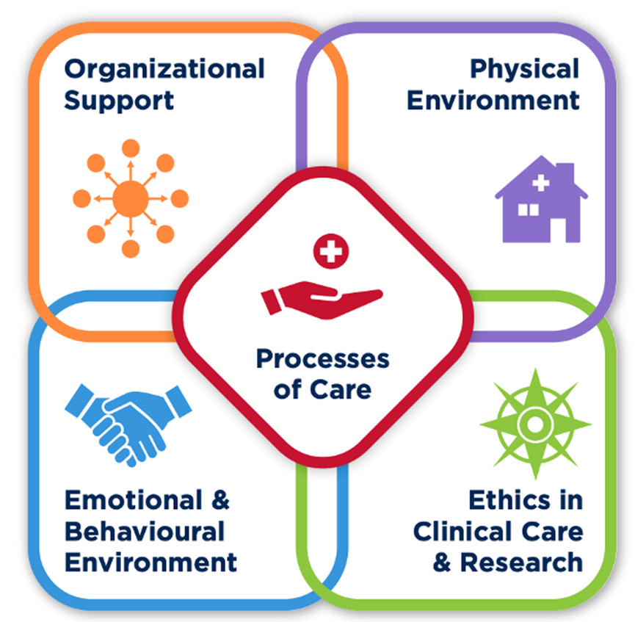
Transitions

Slide 19
Options to Care
Aging in Place
Specialized Features
Independent Living
Assisted Living
Transitional Care
Long Term Care
Adult Day Programs
Behavior Support Programs
Cultural & Language Specific
Short Stay Respite Care
On-Line Programs (Baycrest @ Home)

Slide 20
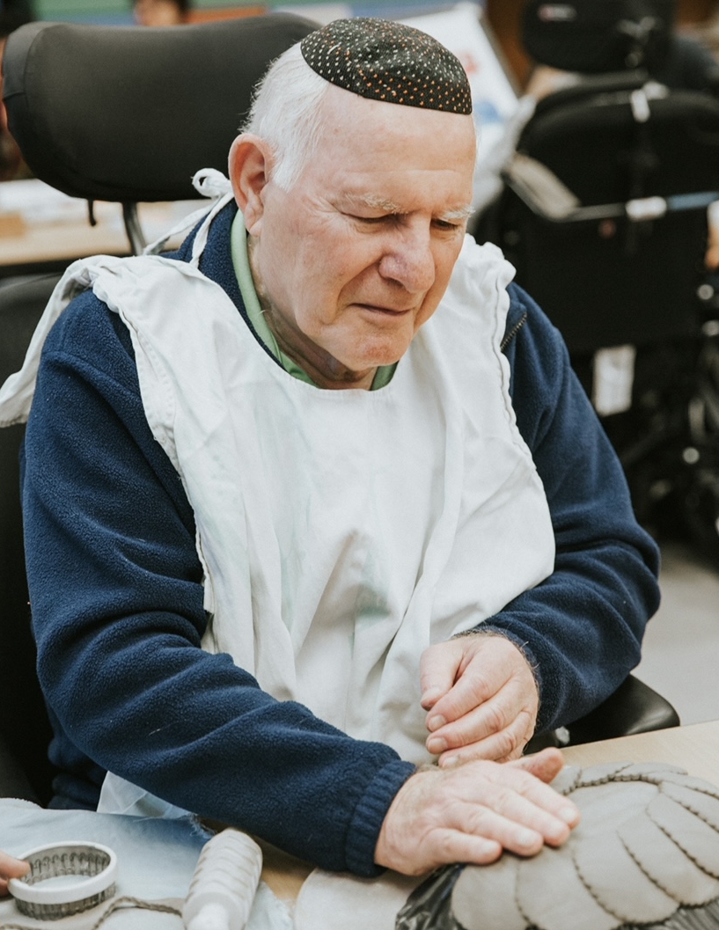
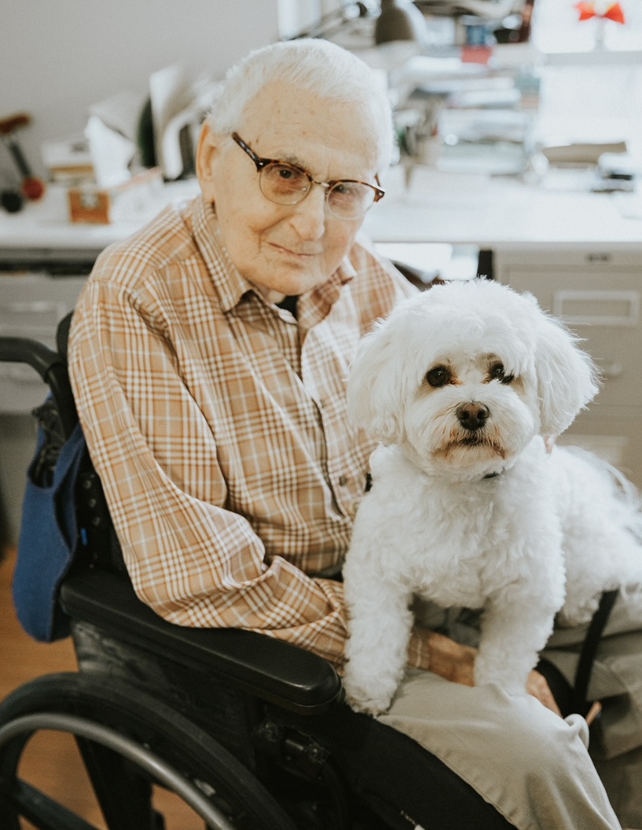
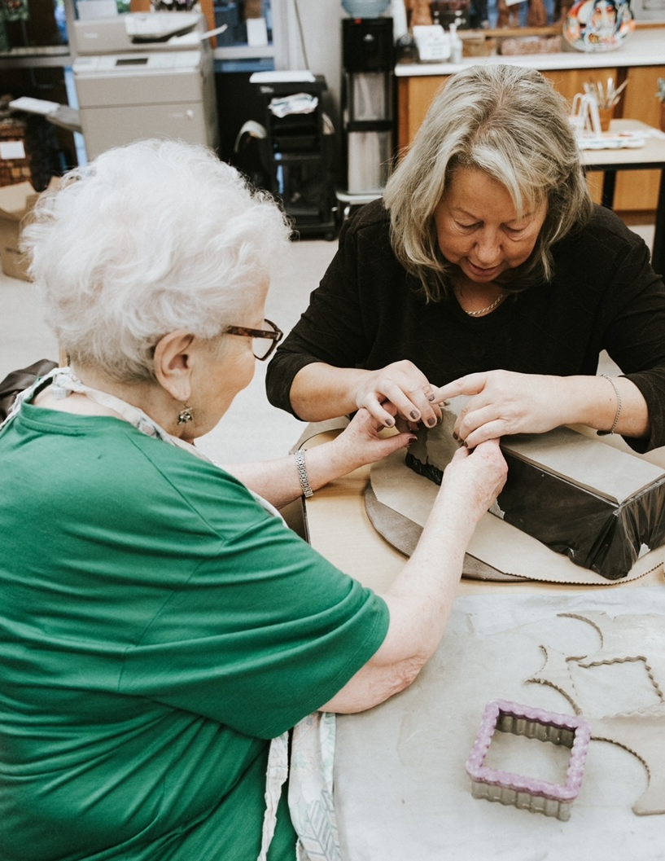
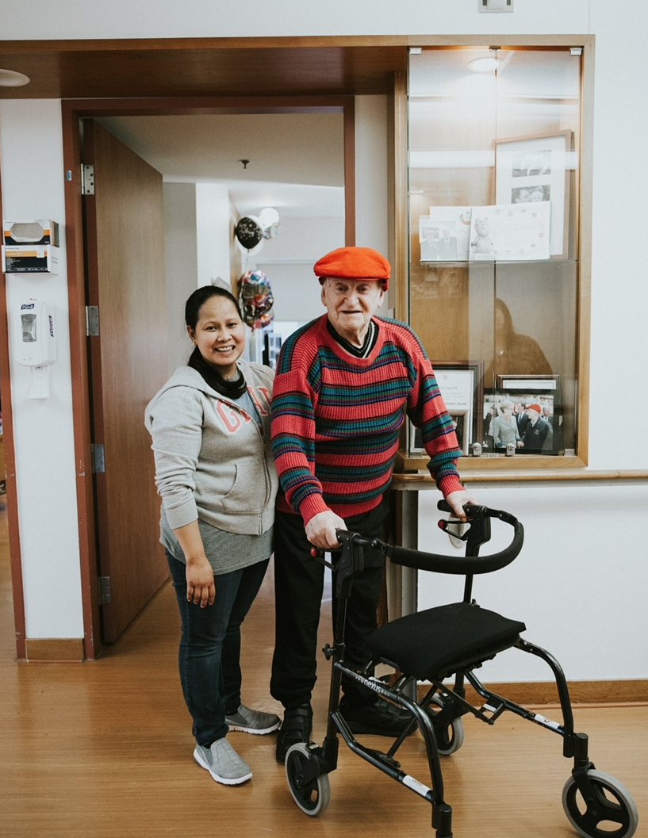
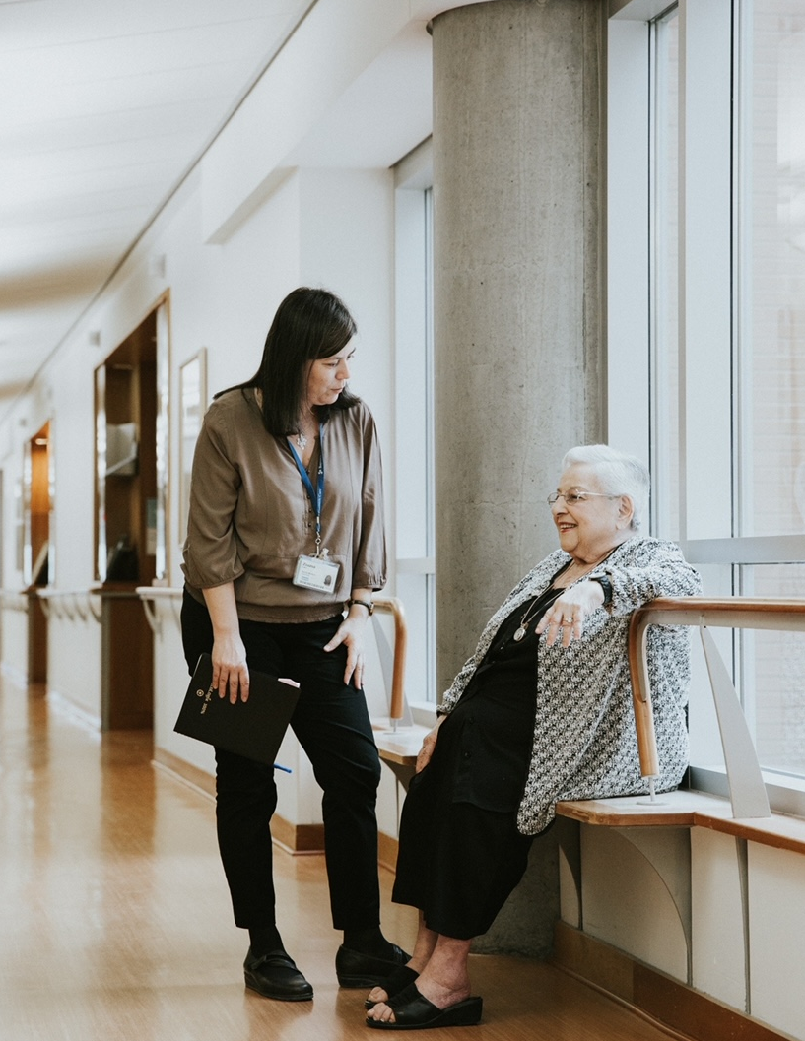
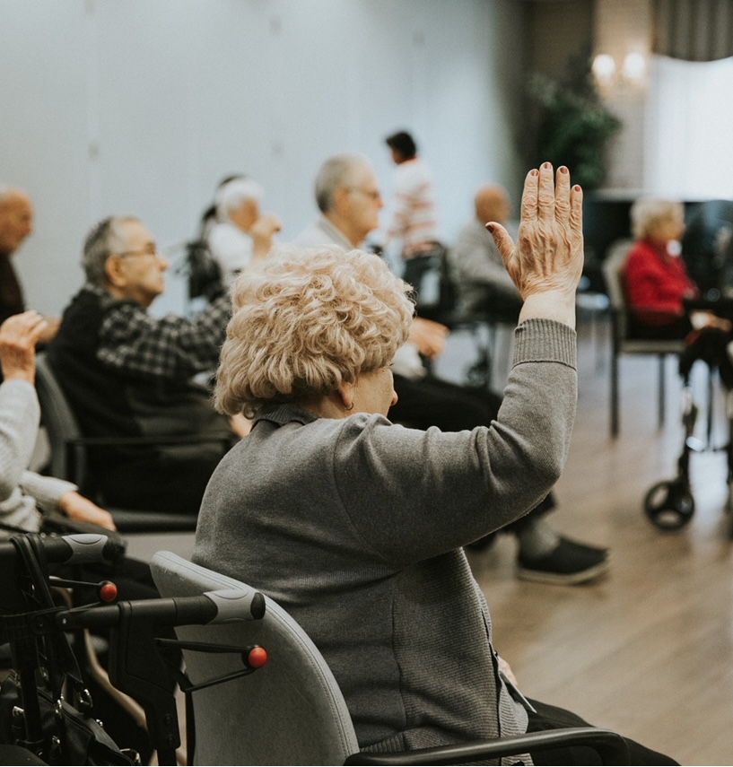

Slide 21
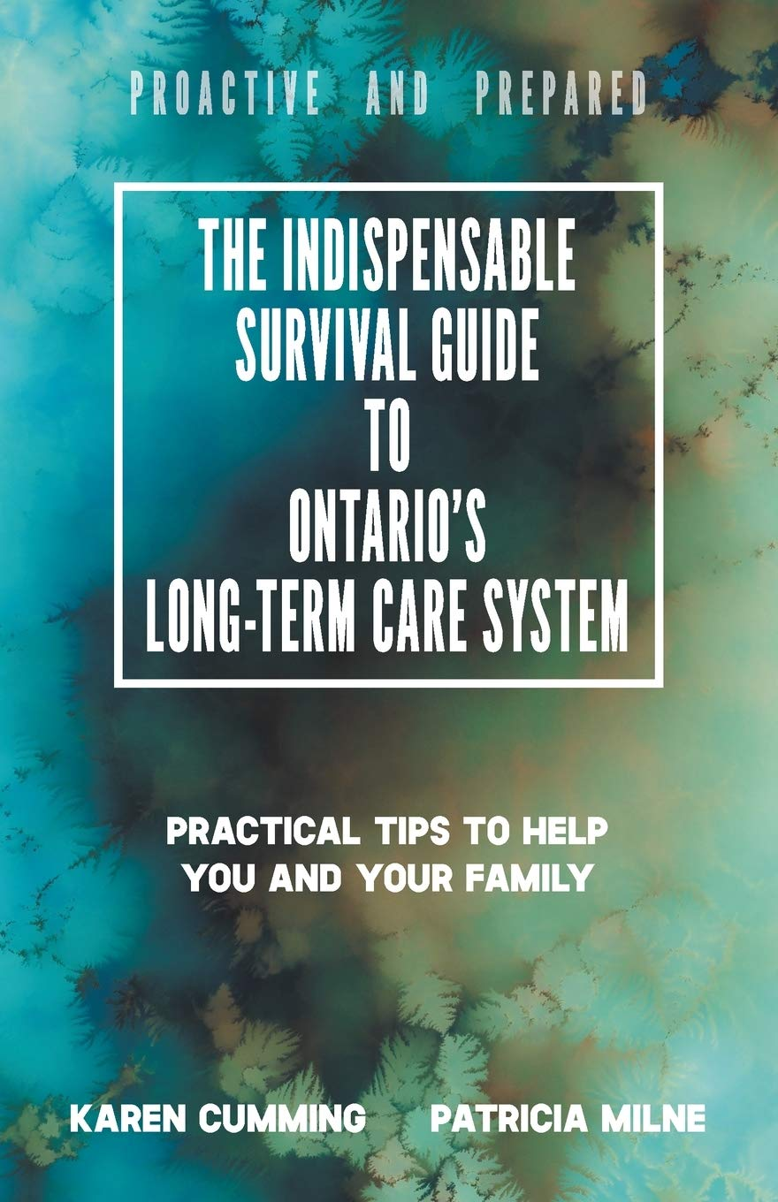

Slide 22


Slide 23
Baycrest @ Home

Slide 24
Resources
"WHOQOL: Measuring Quality of Life". World Health Organization. Archived from the original on 15 May 2020. Retrieved 22 May 2020.
Gregory, Derek; Johnston, Ron; Pratt, Geraldine; Watts, Michael; et al., eds. (June 2009). "Quality of Life". Dictionary of Human Geography (5th ed.). Oxford: Wiley-Blackwell. ISBN 978-1-4051-3287-9.
Martha Nussbaum and Amartya Sen, ed. (1993). The Quality of Life, Oxford: Clarendon Press. Description and chapter-preview links. Archived 11 February 2019 at the Wayback Machine
Barcaccia, Barbara (4 September 2013). "Quality Of Life: Everyone Wants It, But What Is It?". Forbes/ Education. Archived from the original on 22 May 2019. Retrieved 10 May 2016.
Bottomley, Andrew (2002). "The Cancer Patient and Quality of Life". The Oncologist. 7 (2): 120–125. doi:10.1634/theoncologist.7-2-120. ISSN 1083-7159. PMID 11961195. S2CID 20903110.
Baycrest: Center-Brain Health Innovation
McMaster Optimal Aging Portal

