Slide 1
Exploring Cross-cultural Dimensions of Institutional Care of Seniors
Andy Chung (MDiv, MCS, Specialist-CASC, RP-CRPO)
(Spiritual and Religious Care Practitioner)

Slide 2
How do you define Dignity?
Society: Loss of normal capability and independence (useless)

Slide 3
Accept dependency as an unpleasant but inescapable fact of the condition. Accept the care they needed with grace and dignity (Dr. Byock)
For dementia, making a man sense of worth and self esteem, his life had been worthwhile

Slide 4
Objectives
Introduce the cultural aspects for physical, psychological, social and Spiritual needs
Palliative Care and Bereavement support

Slide 5
Chinese culture: Physical, Psychological, Social and Spiritual

Slide 6
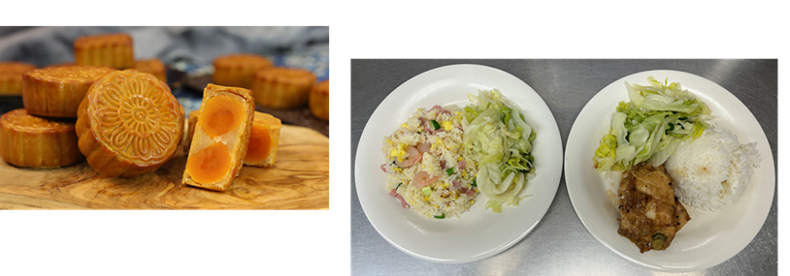
Physical needs
Cultural Food:
> Chinese Food, especially soups,
> Especially 1st and 15th day of the month in
Chinese calendar or special day to arrange vegetarian’s meal for residents to choose

Slide 7
Psychological needs

Slide 8
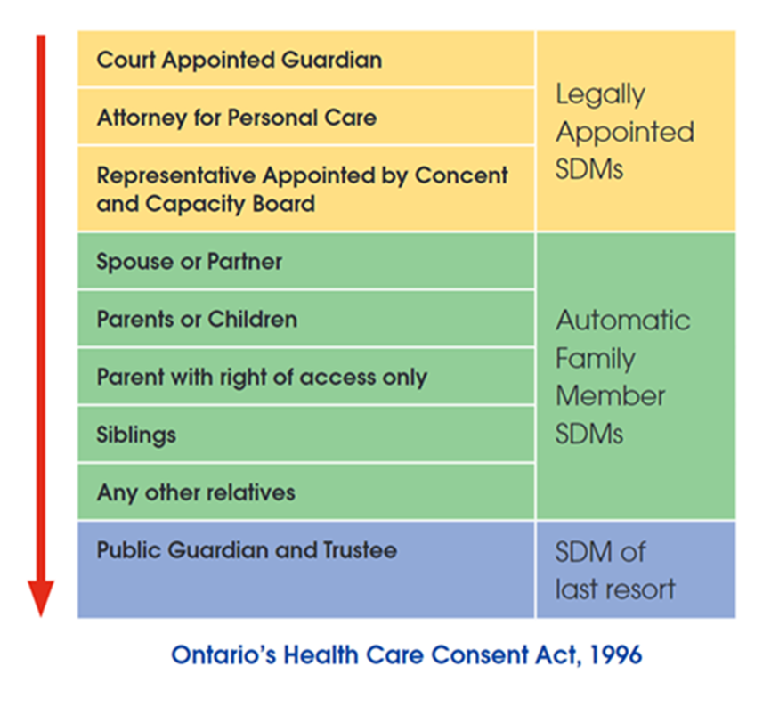
Decision making (Family dynamic)
According to Confucian beliefs, family relationships are hierarchical in nature. Lower ranked individuals in these hierarchical relationships must show obedience, loyalty, and respect to the higher ranked individual.

Slide 9
Examples

Slide 10
Exceptional case
In traditional Chinese families, even if an elder sister is present, the younger son often makes significant decisions.

Slide 11
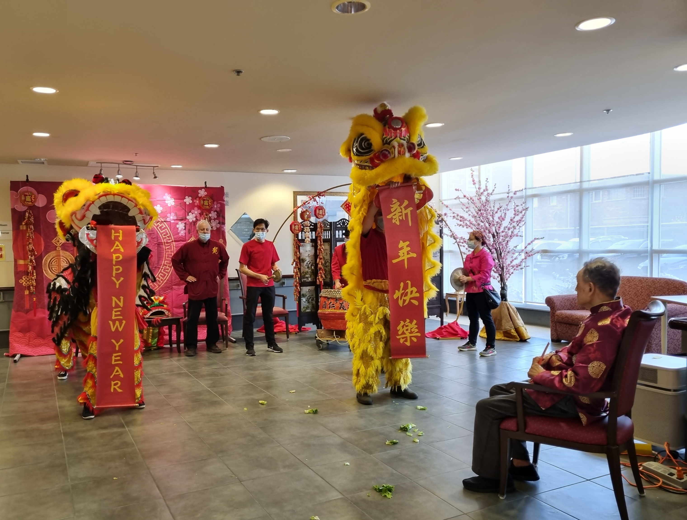
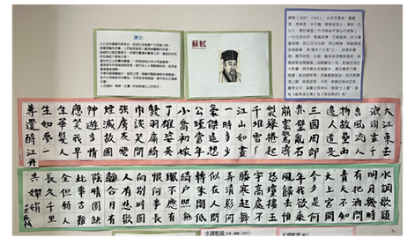
Social needs
Chinese Decorations (Brush calligraphy)
Games (Playing Mah-jong)
Celebrate the Chinese Festivals

Slide 12
Spiritual needs
Multifaith: Ancestor worship, Buddhism, Catholic, Christian
Traditional worship: followed the parents’ practice
Special Events
Lunar New Year (Jan/Feb),
Ching Ming Festival (Apr) and Chung Yeung Festival (Oct)

Slide 13
Facing the Loss of their loved one, their children and friends

Slide 14
Palliative Care and Bereavement Support
Myth:
Die before special events (Traditional brief)
Life: fight until the last moment

Slide 15
“Death” issue:
Openness of Resident vs Family
Pain and suffering (Physical/psychological/Spiritual)
Nutrition and Hydration (Die in hunger)

Slide 16
Post-mortem
Wear their own clothes after death
Different religious practice
Memorial service (On April and October)

Slide 17
Question
How importance for LTC home to provide the service in cultural aspects?

Slide 18
Reference
Byock, I. (1997). Dying Well – Peace and Possibilities at the End of Life. Riverhead Books.
LinYutang. (1995) Crossing the Gate of Death in Chinese Buddhist Culture

Slide 19
Thank You!

